Slide 1
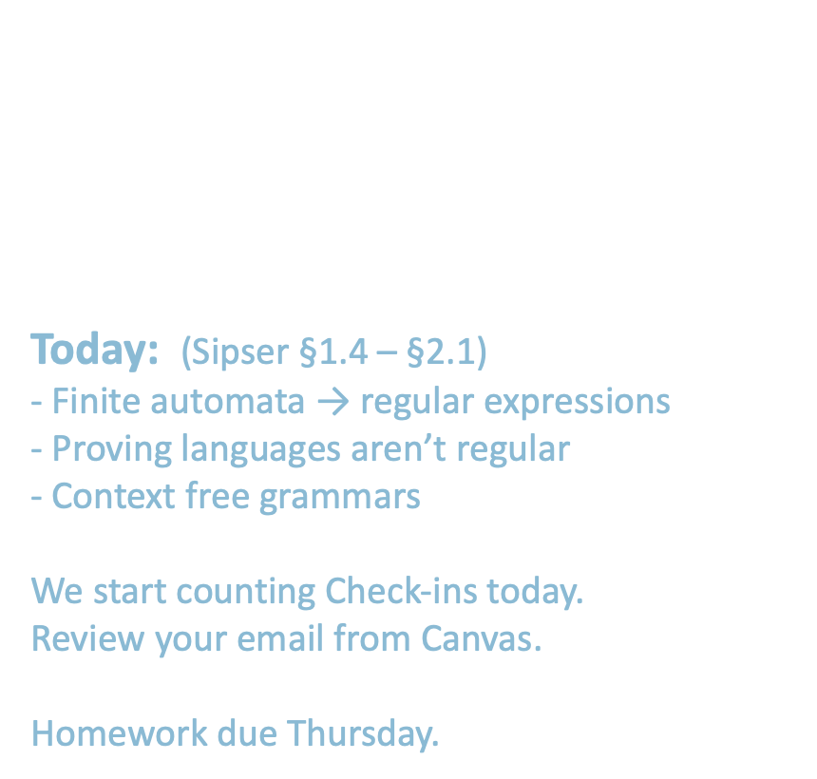
18.404/6.840 Lecture 3
Last time: - Nondeterminism - NFA → DFA - Closure under $∘$ and $∗$
- Regular expressions → finite automata
Today: (Sipser §1.4 – §2.1) - Finite automata → regular expressions - Proving languages aren’t regular
- Context free grammars
We start counting Check-ins today. Review your email from Canvas.
Homework due Thursday.
1

Slide 2



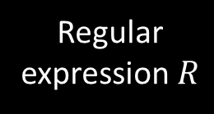


DFAs $→$Regular Expressions
Recall Theorem: If $R$ is a regular expressipn and $A=L\left(R\right)$ then $A$ is regular
Proof: Conversion $R$ $→$NFA $M$ $→$ DFA $M′$
$$M$$
Regular expression $R$
Finite automaton
Recall: we did ${\left(\text{a}∪\text{ab}\right)}^{∗}$ as an example
It is the language of some finite automaton
Today’s Theorem: If $A$ is regular then $A=L\left(R\right)$ for some regular expr $R$
Proof: Give conversion DFA $M$ $→$ $R$
WAIT! Need new concept first.
2

Slide 3










Generalized NFA
Defn: A Generalized Nondeterministic Finite Automaton (GNFA) is similar to an NFA, but allows regular expressions as transition labels
Read a hole string one step and check the chunk of that read whether in the regular expression
$$G1$$
a
$${\text{a}}^{∗}{\text{b}}^{∗}$$
ab
$$q2$$
We could easily modify the machine to achieve that
$$q1$$
b
For convenience we will assume:
- One accept state, separate from the start state
- One arrow from each state to each state, except
a) only exiting the start state b) only entering the accept state
We can easily modify a GNFA to have this special form.
$$\text{ε}$$
$$∅$$
$$\text{a}∪\text{b}$$
aab
$$q3$$
$$\text{ε}$$
$$q4$$
3

Slide 4







GNFA $→$Regular Expressions
Lemma: Every GNFA $G$ has an equivalent regular expression $R$
Proof: By induction on the number of states $k$ of $G$
Basis $(k=2)$:
Let $R=r$
Induction step $(k>2)$: Assume Lemma true for $k−1$ states and prove for $k$ states
IDEA: Convert $k$-state GNFA to equivalent $\left(k−1\right)$ -state GNFA
a recursive proof that calls itself
The whole name of the game here is figuring out how to convert a GNFA that has k states into another one that has k-1 states that does the same language
$$G=$$
$$r$$
Remember: $G$ is in special form
By definition: When k = 2, G must like this
GNFA
GNFA
$k$ states
$k−1$ states
4

Slide 5










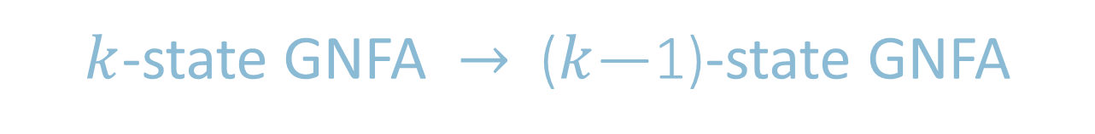




$k$-state GNFA $→$ ($k$—1)-state GNFA
Look at all the path that could go through x and make sure that they are still present even though I don’t have x anymore
Rip out
$$x$$
$$r_{2}$$
$$x$$
$$r_{1}$$
$$r_{3}$$
Pick any state $x$ except the start and accept states.
Remove $x$.
Repair the damage by recovering all paths that went through $x$.
Make the indicated change for each pair of states $q_{i}, q_{j}$ .
$$q_{i}$$
$$q_{j}$$
$$q_{i}$$
$$q_{j}$$
$$r_{4}$$
$$r_{1}{\left(r_{2}\right)}^{∗}r_{3}∪r_{4}$$
Adds in all the things I lost when I removed x
compensated
$k$ states
$k−1$ states
Thus DFAs and regular expressions are equivalent.
5

Slide 6
Conclusion
Regular Languages
Definition:
A language is regular if some deterministic finite automaton M recognizes it.
DFAs
Closure Properties
Proof by construction
If an NFA recognizes A then A is regular
NFAs
If Re is a regular expr and A = L(Re) then A is regular Language
Proof by introduction
K state GNFA -> (k – 1)state GNFA
GNFAs
Regular Expressions

Slide 7
RISC vs CISC
Reduced Instruction Set Computer
Complex Instruction Set Computer
------------
------------------------------------------------------------------------------------------------------------------------
CPU and Hardware Design
--------------------
----------
------------------
-------------
Compiler Design
Registers and Instruction Memory
Clock Cycles (generally)
Flexibility (freedom)

Slide 8
Check-in 3.1
We just showed how to convert GNFAs to regular expressions but our goal was to show that how to convert DFAs to regular expressions. How do we finish our goal?
Show how to convert DFAs to GNFAs
Show how to convert GNFAs to DFAs
We are already done. DFAs are a type of GNFAs.
All DFAs are automatically GNFAs
We’ve already shown that regular languages can either come from regular expressions or DFAs
Check-in 3.1

Slide 9
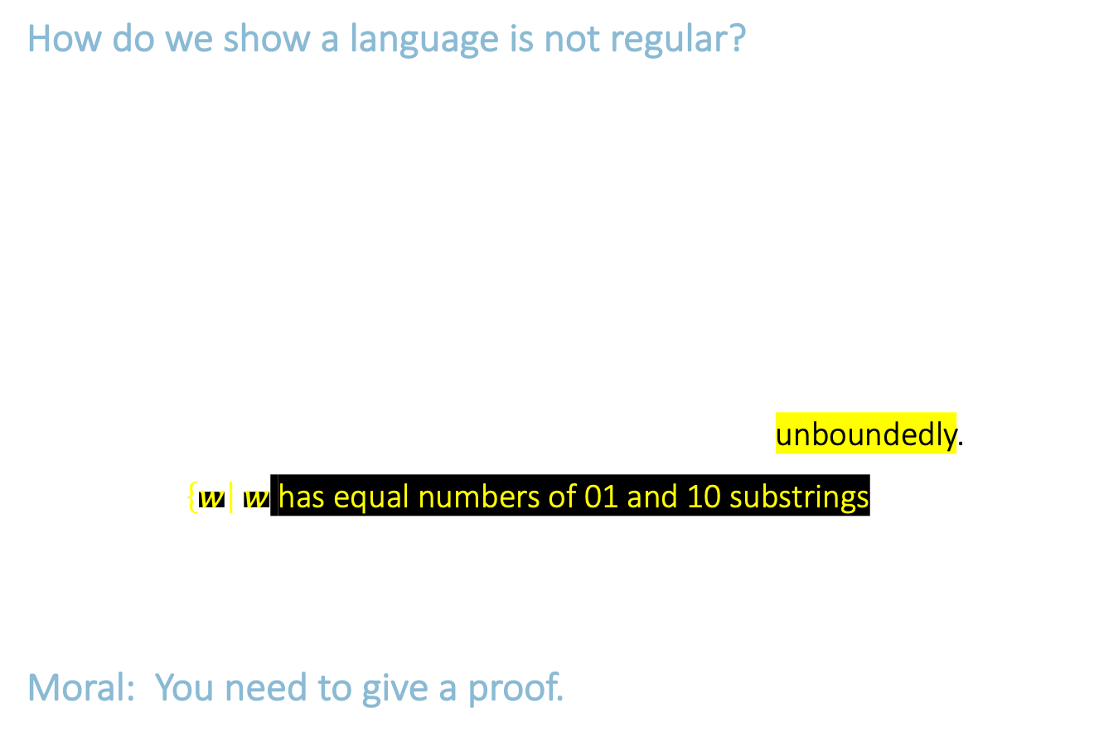
Non-Regular Languages
How do we show a language is not regular?
- Remember, to show a language is regular, we give a DFA.
- To show a language is not regular, we must give a proof.
- It is not enough to say that you couldn’t find a DFA for it, therefore the language isn’t regular.
Two examples: Here $Σ=\{0,1\}$.
1. Let $B=\left\{w\right| w$ has equal numbers of 0s and 1s$\}$
Intuition: $B$ is not regular because DFAs cannot count unboundedly.
2. Let $C=\left\{w\right| w$ has equal numbers of 01 and 10 substrings$\}$ 0101 $∉C$ 0110 $∈C$
Intuition: $C$ is not regular because DFAs cannot count unboundedly.
However $C$ is regular! Sometimes intuition works, but it can also be wrong.
Moral: You need to give a proof.
DFAs are weak as a computation model
There is all sorts of things that they cannot do
Though there are some complicated things that they can do, surprisingly enough
]
]
]
Set of all strings that end and start with the same character (0 or 1)
]
]
6

Slide 10



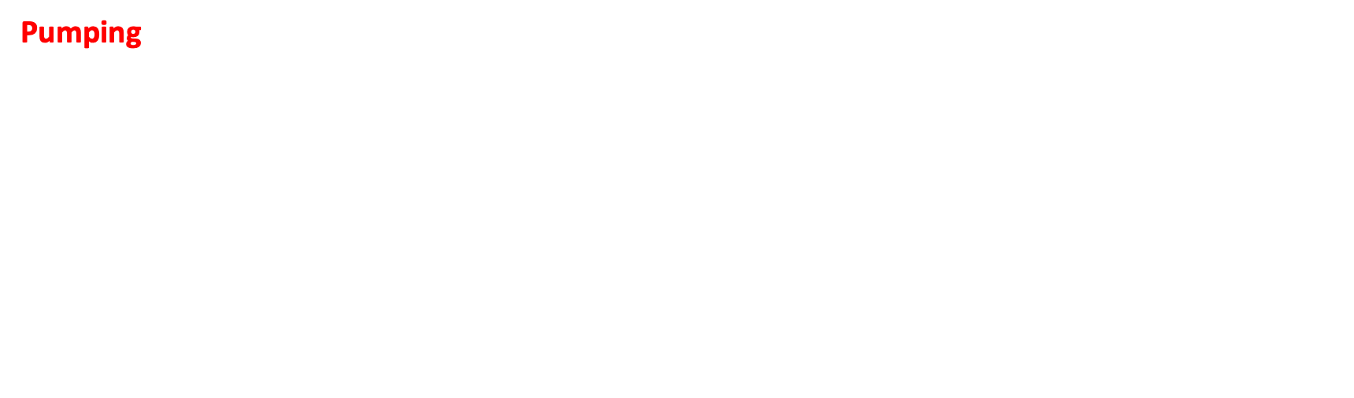



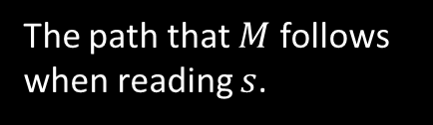
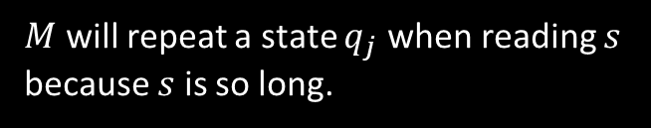













Method for Proving Non-regularity
Pumped means I can cut the string into three pieces and repeat that middle piece as many times as I want
Pumping Lemma: For every regular language $A$, there is a number $p$ (the “pumping length”) such that if $s∈A$ and $\left|s\right|≥p$ then $s=xyz$ where
1) $xy^{i}z∈A$ for all $i≥0$ $y^{i}=yy⋯y$
2) $y≠\text{ε}$
3) $\left|xy\right|≤p$
Informally: $A$ is regular → every long string in $A$ can be pumped and the result stays in $A$.
Proof: Let DFA $M$ recognize $A$. Let $p$ be the number of states in $M$. Pick $s∈A$ where $\left|s\right|≥p$.
}
$$i$$
$$s=$$
$$x$$
$$y$$
$$z$$
$$M$$
$$y$$
$$q_{j}$$
$$q_{j}$$
$$q_{j}$$
The path that $M$ follows when reading $s$.
$M$ will repeat a state $q_{j}$ when reading $s$ because $s$ is so long.
$$x$$
$$z$$
$$x$$
$$y$$
$$y$$
$$z$$
$$q_{j}$$
$$q_{j}$$
$$q_{j}$$
is also accepted
7

Slide 11
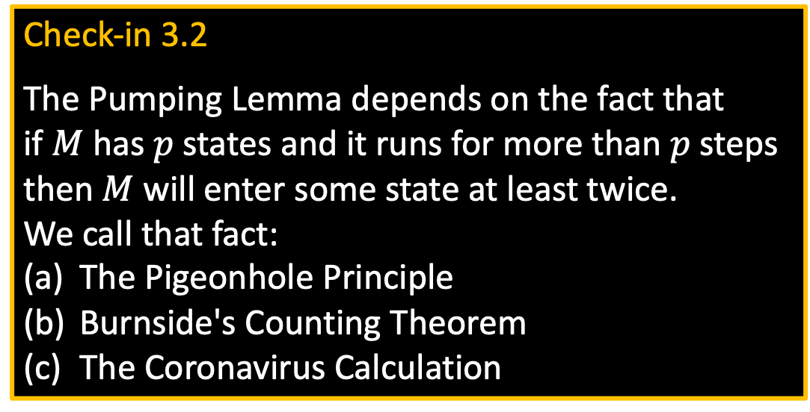
Check-in 3.2
The Pumping Lemma depends on the fact that if $M$ has $p$ states and it runs for more than $p$ steps then $M$ will enter some state at least twice. We call that fact:
The Pigeonhole Principle
Burnside's Counting Theorem
The Coronavirus Calculation
Check-in 3.2

Slide 12







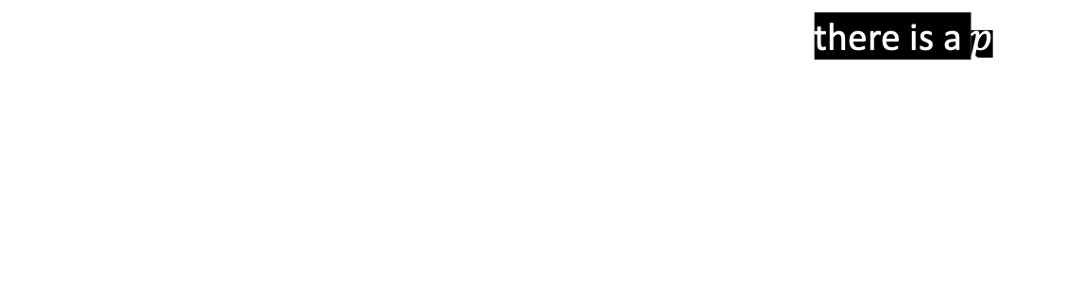
Example 1 of Proving Non-regularity
Pumping Lemma: For every regular language $A$, there is a $p$ such that if $s∈A$ and $\left|s\right|≥p$ then $s=xyz$ where
1) $xy^{i}z∈A$ for all $i≥0$ $y^{i}=yy⋯y$
2) $y≠\text{ε}$
3) $\left|xy\right|≤p$
Let $D=\left\{0^{k}1^{k}\right| k≥0\}$
Show: $D$ is not regular
Proof by Contradiction:
Assume (to get a contradiction) that $D$ is regular.
The pumping lemma gives $p$ as above. Let $s=0^{p}1^{p}∈D$.
Pumping lemma says that can divide $s=xyz$ satisfying the 3 conditions.
But $xyyz$ has excess 0s and thus $xyyz∉D$ contradicting the pumping lemma. Therefore our assumption ($D$ is regular) is false. We conclude that $D$ is not regular.
Just need to find one incorrect p
We do not know how large is k
There will be lots of zeros followed by not so many ones
$$s=$$
$$000⋯000111⋯111$$
$$x$$
$$y$$
$$z$$
$$≤p$$
8

Slide 13














Example 2 of Proving Non-regularity
Pumping Lemma: For every regular language $A$, there is a $p$ such that if $s∈A$ and $\left|s\right|≥p$ then $s=xyz$ where
1) $xy^{i}z∈A$ for all $i≥0$ $y^{i}=yy⋯y$
2) $y≠\text{ε}$
3) $\left|xy\right|≤p$
Let $F=\left\{ww\right| w∈Σ^{∗}\} .$ Say $Σ^{∗}=\{0,1\}$.
Show: $F$ is not regular
Proof by Contradiction:
Assume (for contradiction) that $F$ is regular.
The pumping lemma gives $p$ as above. Need to choose $s∈F$. Which $s$?
Try $s=0^{p}0^{p}∈F$. But that $s$ can be pumped and stay inside $F$. Bad choice.
Try $s=0^{p}{10}^{p}1∈F$. Show cannot be pumped $s=xyz$ satisfying the 3 conditions.
$xyyz∉F$ Contradiction! Therefore $F$ is not regular.
$$s=$$
$$000⋯000000⋯000$$
$$x$$
$$y$$
$$z$$
$$≤p$$
$$y=00$$
$$s=$$
$$000⋯001000⋯001$$
$$x$$
$$y$$
$$z$$
$$≤p$$
9

Slide 14

Example 3 of Proving Non-regularity
Variant: Combine closure properties with the Pumping Lemma.
Let $B=\left\{w\right| w$ has equal numbers of 0s and 1s$\}$
Show: $B$ is not regular
Proof by Contradiction:
Assume (for contradiction) that $B$ is regular.
We know that $0^{∗}1^{∗}$ is regular so $B∩0^{∗}1^{∗}$ is regular (closure under intersection).
But $D= B∩0^{∗}1^{∗}$ and we already showed $D$ is not regular. Contradiction!
Therefore our assumption is false, so $B$ is not regular.
D is equal to ( 0^n 1^n)
10

Slide 15




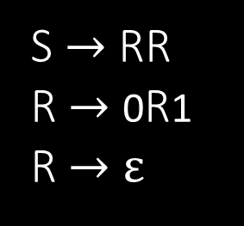




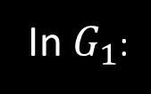
Context Free Grammars
$$G_{1}$$
}
S $→$ 0S1
S $→$ R
R $→$ $ε$
(Substitution) Rules
In $G_{1}$:
$$G_{2}$$
S $→$ RR
R $→$ 0R1
R $→$ $ε$
Rule: Variable $→$ string of variables and terminals
Variables: Symbols appearing on left-hand side of rule
Terminals: Symbols appearing only on right-hand s$ide$
Start Variable: Top left symbol
Grammars generate strings
Write down start variable
Replace any variable according to a rule Repeat until only terminals remain
Result is the generated string
$L(G)$ is the language of all generated strings.
3 rules
R,S
0,1
S
Example of $G_{1}$ generating a string
Tree of substitutions
S
0S1
0S1
R
$$ε$$
S
0S1
00S11
00R11
0011
Resulting string
$$∈L\left(G_{1}\right)$$
$$L\left(G_{1}\right)=\left\{0^{k}1^{k}\right| k≥0\}$$
11
Check-in 3.3

Slide 16
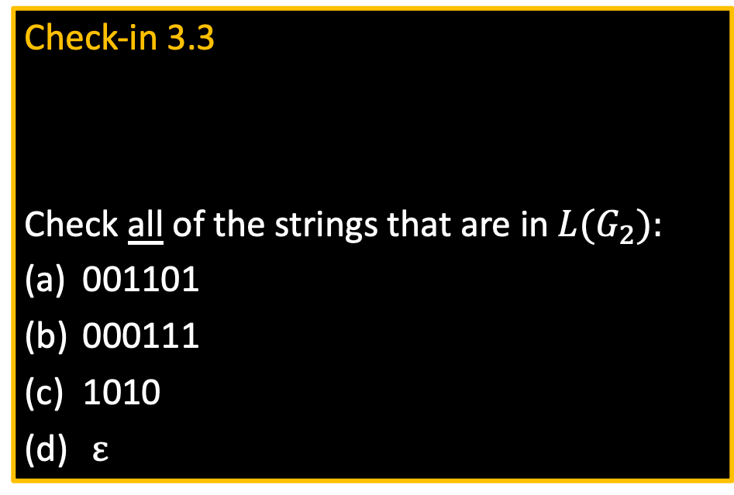
Check-in 3.3
Check all of the strings that are in $L(G_{2}):$
001101
000111
1010
$ε$
Ans:
A B D

Slide 17
Quick review of today
Conversion of DFAs to regular expressions Summary: DFAs, NFAs, regular expressions are all equivalent
Proving languages not regular by using the pumping lemma and closure properties
Context Free Grammars
12

Slide 18
MIT OpenCourseWare
https://ocw.mit.edu
18.404J Theory of Computation
Fall 2020
For information about citing these materials or our Terms of Use, visit: https://ocw.mit.edu/terms.

